Slide 1
ENGI 301 Bartending Robot PCB Proposal
4/10/2022
Alex Prucka

Slide 2
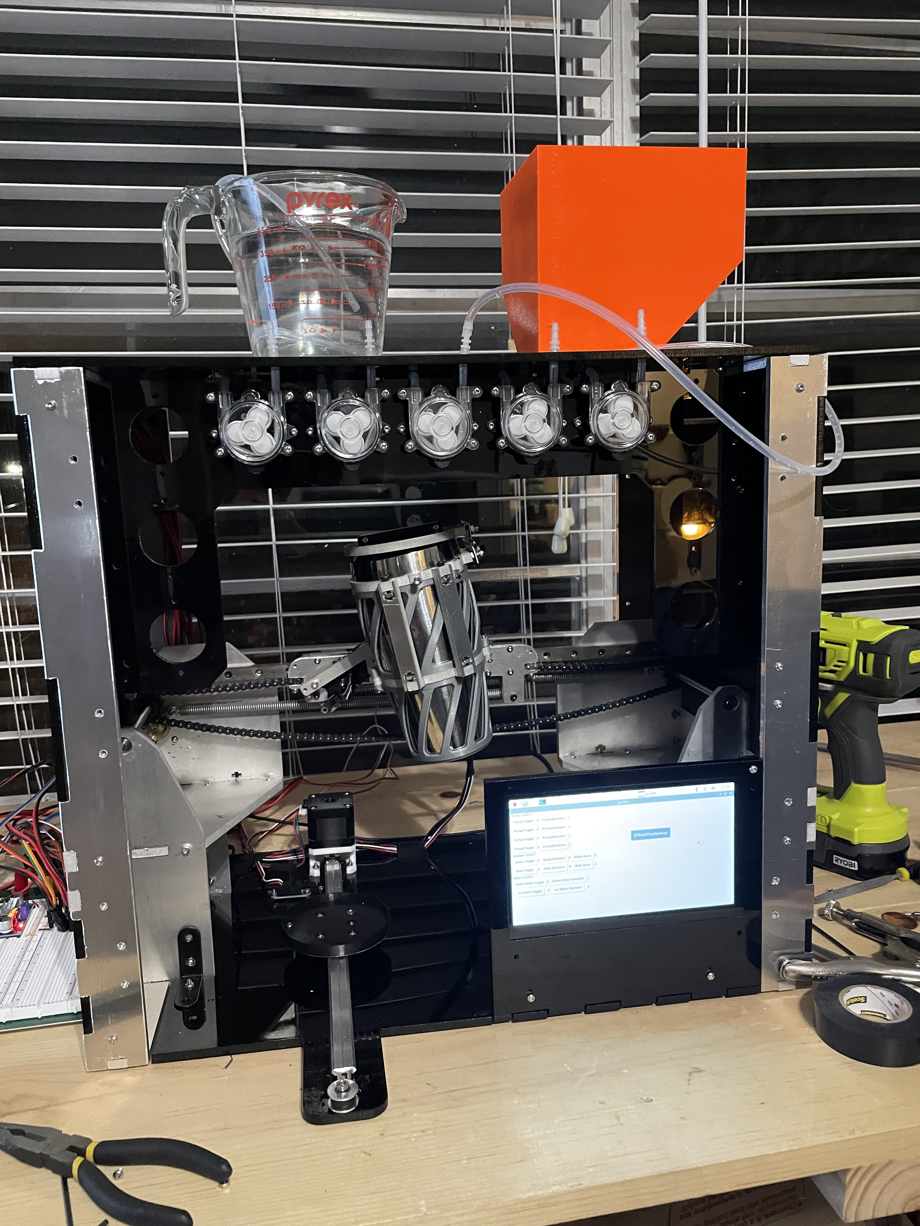
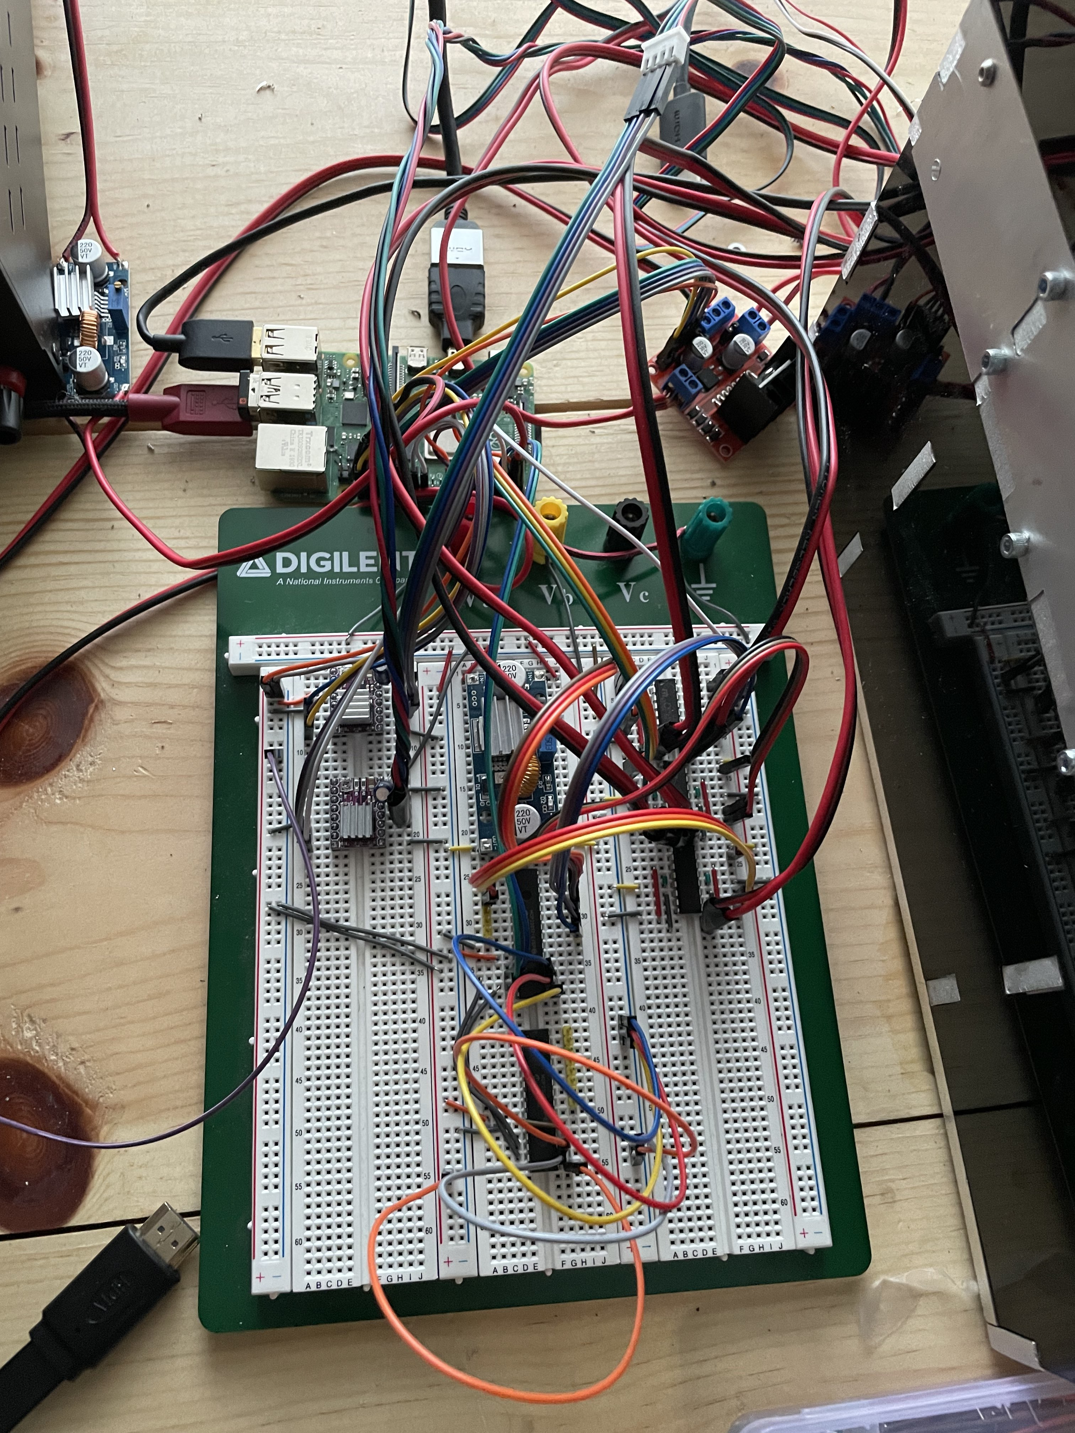
Background Information
I am proposing to design and build a board which will provide the functions which my current breadboard setup provides for the bartending robot in a much more efficient package
The PCB will implement the controllers for all 11 of the pumps. Only 4 were controllable in the breadboard setup.

Slide 3
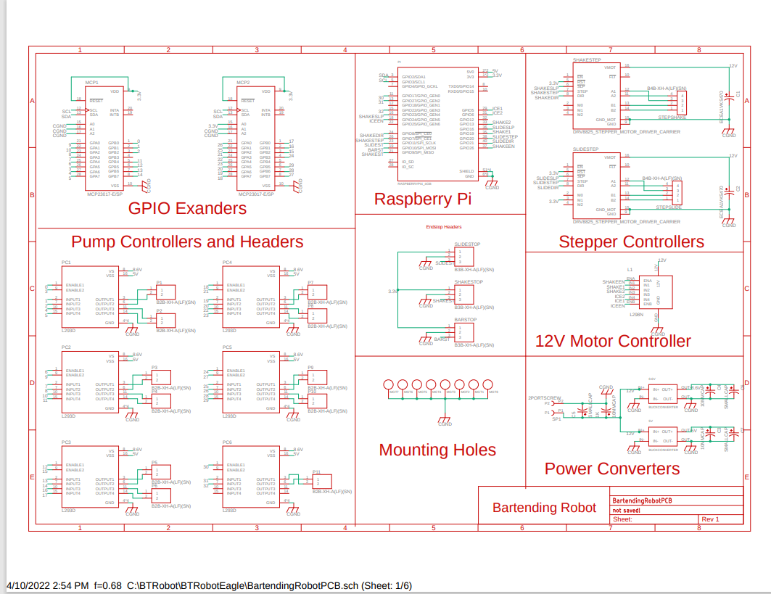
System Block Diagram

Slide 4
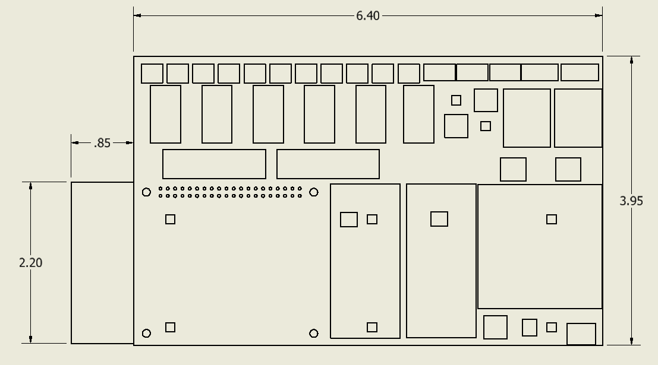
Mechanical Block Diagram

Slide 5
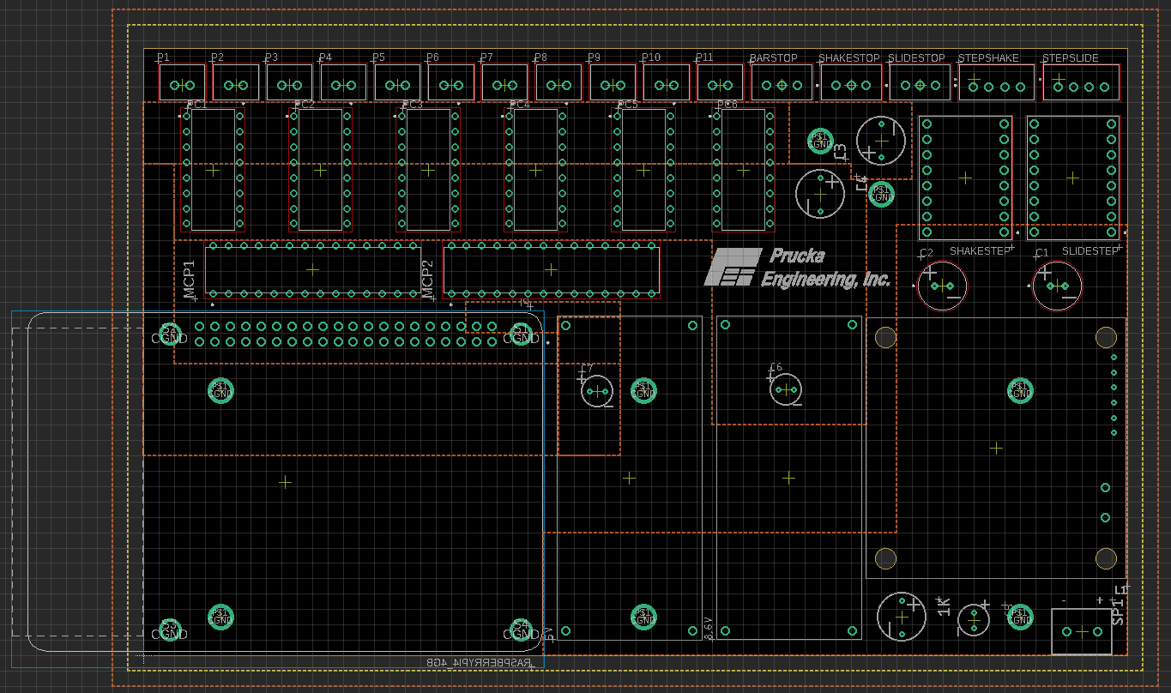

Slide 6
Components Required
All of the required components are things that I used on the breadboard project, and thus still have and will populate the PCB with when it arrives

